Slide 1

HEART FAILURE PREDICTION
Submitted by :
S.Faiyajuddin
K. Sai Teja
G. Chandra Shekar
K. Jayaprakash
D. Nithin

Slide 2
ABSTRACT :
People with cardiovascular disease or who are at high cardiovascular risk (due to the presence of one or more risk factors such as hypertension, diabetes, hyperlipidaemia or already established disease) need early detection and management wherein a machine learning model can be of great help. In this way, we try to solve automate another problem that occurs in the nature with a view to counter it and focus on to the next problem with the help of AI techniques.
Cardiovascular diseases (CVDs) are the number 1 cause of death globally, taking an estimated 17.9 million lives each year, which accounts for 31% of all deaths worldwide.

Slide 3
Problem Definition :
The major challenge in heart disease is its detection. There are instruments available which can predict heart disease but either they are expensive or are not efficient to calculate chance of heart disease in human. Early detection of cardiac diseases can decrease the mortality rate and overall complications.
Objectives :
1. To develop machine learning model to predict future possibility of heart disease by implementing Logistic Regression.
2.To determine significant risk factors based on medical dataset which may lead to heart disease.

Slide 4
Data Set Description :
Age : age of the patient [years]
Sex : sex of the patient [M: Male, F: Female]
ChestPainType : chest pain type [TA: Typical Angina, ATA: Atypical Angina, NAP:Non-Anginal Pain, ASY: Asymptomatic]
RestingBP : resting blood pressure [mm Hg]
Cholesterol : serum cholesterol [mm/dl]
FastingBS : fasting blood sugar [1: if FastingBS > 120 mg/dl, 0: otherwise]
RestingECG : resting electrocardiogram results [Normal: Normal, ST: having ST-T wave abnormality
LVH: showing probable or definite left ventricular hypertrophy by Estes' criteria]
MaxHR : maximum heart rate achieved [Numeric value between 60 and 202]
ExerciseAngina : exercise-induced angina [Y: Yes, N: No]
Oldpeak : = ST [Numeric value measured in depression]
ST_Slope : the slope of the peak exercise ST segment [Up: upsloping, Flat: flat, Down: downsloping]
HeartDisease : output class [1: heart disease, 0: Normal]

Slide 5
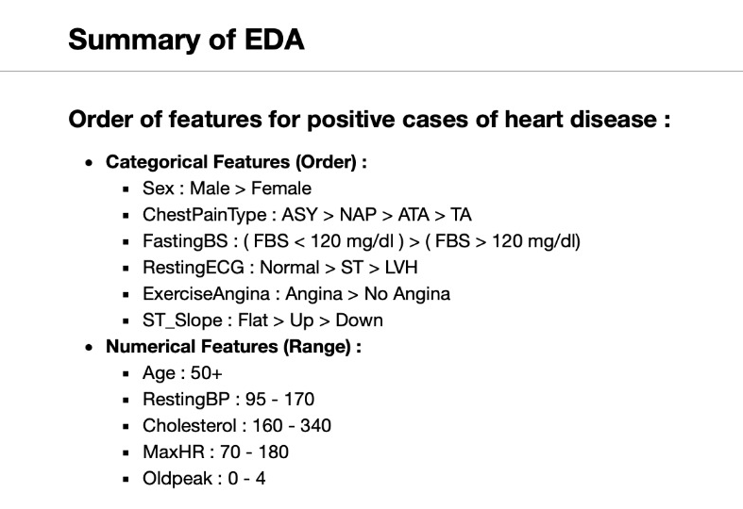

Slide 6
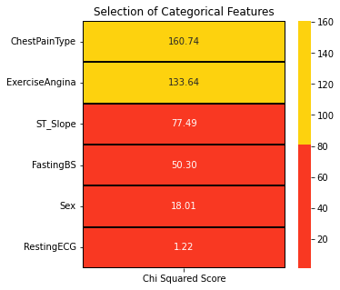
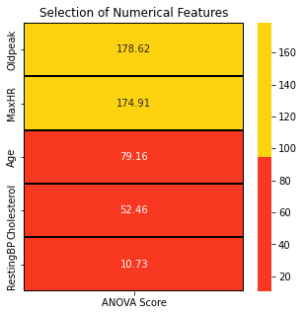
Feature selection :

Slide 7
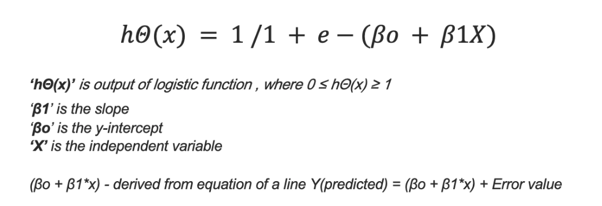
Logistic Regression :
Logistic regression is a statistical method that is used for building machine learning models where the dependent variable is dichotomous: i.e. binary. Logistic regression is used to describe data and the relationship between one dependent variable and one or more independent variables. The independent variables can be nominal, ordinal, or of interval type.
Mathematical representation of logistic regression :

Slide 8
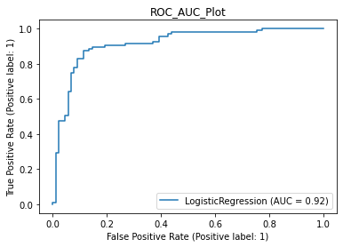
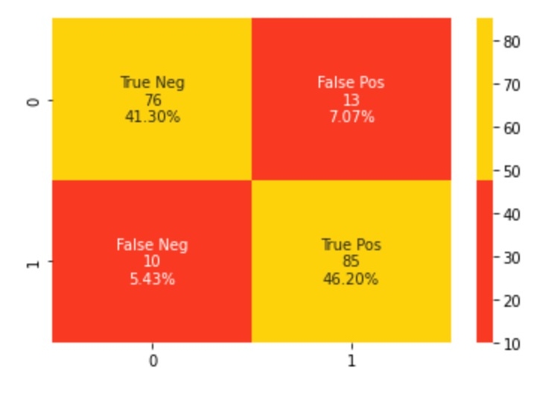
Results :
Model Evaluation
Accuracy : 87.50%
Cross Validation Score : 91.12%
ROC_AUC Score : 87.43%
Confusion Matrix :

Slide 9
CONCLUSION :
This dataset is great for understanding how to handle binary classification problems with the combination of numerical and categorical features.
The result is 87.50 % accurate
For modeling, hyperparameter tuning is not done. It can push the performances of the algorithms.

Slide 10
THANK YOU

